Slide 1
OWENS & MINOR INC.
Entering Europe
Presented for Mr. Smith - President and CEO, Mr. Bierman - Executive VP and COO

Slide 2
EXECUTIVE SUMMARY
How can Owens & Minor integrate Movianto acquisition and deliver quality health on global scale?
Where you
are now
Movianto’s needs to be effectively integrated into O&M’s organizational culture
Each country in Europe has unique industry structure
Benefits from O&M’s pre-existing US knowledge in EU are uncertain
Challenges
Adapt Movianto to O&M’s culture
Optimize distribution structure
Integrate O&M’s experience to new markets
Strategy
Owens & Minor will dominate the relationship between manufacturers and point of care providers
Where you will be

Slide 3
1
Challenges
2
Recommendations
3
Implementation
4
Financial Feasibility
5
Risks & Mitigations

Slide 4
1
Challenges
2
Recommendations
3
Timeline
4
Financial Feasibility
5
Risks & Mitigations

Slide 5
ADAPTING MOVIANTO INTO O&M CULTURE
How can Owens & Minor integrate Movianto acquisition and deliver quality health on global scale?
Where you
are now
Movianto’s needs to be effectively integrated into O&M’s organizational culture
Each country in Europe has unique industry structure
Benefits from O&M’s pre-existing US knowledge in EU are uncertain
Challenges
Adapt Movianto to O&M’s culture
Optimize distribution structure
Integrate O&M’s experience to new markets
Strategy
Owens & Minor will dominate the relationship between manufacturers and point of care providers
Where you will be

Slide 6
WHY FOCUS ON INTEGRATING MOVIANTO?
OWENS & MINOR
Distribution of medical supplies
4800 employees, 51 facilities
MOVIANTO
3PL for drug manufacturers
1800 employees, 23 facilities
MARKET SHARE: 5.9%
MARKET SIZE: 151B USD
GROWTH: +1.9%
MARKET SHARE: 3%
MARKET SIZE: 54B euros
GROWTH: +7.6%
At +7.6% annually Movianto’s industry is growing significantly faster than O&M’s. Movianto - representing 1/3 of O&M operations – must be effectively integrated to capitalize on this growth.
Source: Case information, IBISWorld
Notes:
GROWTH: +7.6% (next 5 years)
By acquiring Movianto, Owens&Minor has increased its infrastructure by 1/3. Such a large acquisition cannot be left w/o proper integration into the parent company to ensure success.
1/3 of operations
Smaller revenues but way faster growth
Fits well into long term vision

Slide 7
HOW DOES MOVIANTO FIT WITH O&M CULTURE?
OWENS & MINOR
CORE VALUES
MOVIANTO
CORE VALUES
Happy Team Members
Expertise
Communication
Innovation
Feedback
Uncompromised quality
Supportive leadership
Everyone Is Valued
Exceeding Expectations
Best Services By Best People
Cultures of the two companies are mostly aligned in visions, which will enable successful culture shift among Movianto’s employees
Source: Case Information, movianto.com

Slide 8
HOW WERE PAST ACQUISITIONS INTEGRATED?
Supplier Management
MediChoice, OM Direct
PAST ACQUISITIONS
Perigon LLC (2005)
Healthcare supply-chain-solutions company
Distribution & Logistics
Distribution services, CostTrack, Integrated Service Centers, OM Healthcare Logistics
Cyrus (2005)
Tissues implant tracking system innovator
OWENS & MINOR
SERVICES AND SOLUTIONS
Analytics
WISDOM Gold, Data Cleansing and Management, Cost Management Strategies, Clinical and Process Consulting, Resourcing Solutions
Burrows (2008)
Distributor of medical supplies for acute market
Clinical Supply Management
PANDAC, SurgiTrack, Clinical Supply Solutions, Tissue Tracking
Access Diabetic Supply, Direct Diabetic Supply, iCare Medical Supply (2005)
*Divested this business segment in 2008
Historic acquisition practices indicate that company prefers to integrated acquired businesses into O&M culture and operations.
Source: owens-minor.com, Owens & Minor Press Releases

Slide 9
INTEGRATE CULTURE. KEEP BUSINESS PRACTICES
Standalone Unit
Buyer’s Culture
Works best when:
Acquired company is large and has a strong operations
Standalone Unit
Seller’s Culture
Works best when:
Entering a new market, no strong presence in this market
Assimilating Existing Units
Buyer’s Culture
Works best when:
Parent company’s unit needs resources to fuel growth
Assimilating Existing Units
Seller’s Culture
Works best when:
Acquired company has better brand and strong management
FORM OF INTEGRATION
CULTURE INTEGRATION
Source: Technology Innovation Management Review

Slide 10
INTEGRATE CULTURE. KEEP BUSINESS PRACTICES
Standalone Unit
Buyer’s Culture
Works best when:
Acquired company is large and has a strong operations
Standalone Unit
Seller’s Culture
Works best when:
Entering a new market, no strong presence in this market
Movianto’s operations equal half of O&M’s operations
Movianto has strong brand and great customer relationship
Assimilating Existing Units
Buyer’s Culture
Works best when:
Parent company’s unit needs resources to fuel growth
Assimilating Existing Units
Seller’s Culture
Works best when:
Acquired company has better brand and strong management
FORM OF INTEGRATION
Moviento is a successfully run business
CULTURE INTEGRATION
Source: Technology Innovation Management Review

Slide 11
INTEGRATE CULTURE. KEEP BUSINESS PRACTICES
Standalone Unit
Buyer’s Culture
Works best when:
Acquired company is large and has a strong operations
Standalone Unit
Seller’s Culture
Works best when:
Entering a new market, no strong presence in this market
Movianto’s operations equal half of O&M’s operations
Movianto has strong brand and great customer relationship
Assimilating Existing Units
Buyer’s Culture
Works best when:
Parent company’s unit needs resources to fuel growth
Assimilating Existing Units
Seller’s Culture
Works best when:
Acquired company has better brand and strong management
FORM OF INTEGRATION
Moviento is a successfully run business
CULTURE INTEGRATION
Operate Moviento as a standalone unit, but integrate it into O&M organizational culture.
Source: Technology Innovation Management Review

Slide 12
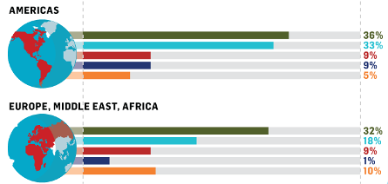

WHERE TO FOCUS DURING INTEGRATION?
PEOPLE ISSUES RECEIVING INSUFFICIENT ATTENTION IN M&A:
Change management and business culture integration should be the main focus in integrating Movianto into Owens&Minor.
Source: Mercer 2012 M&A Ready

Slide 13
CHANGE MANAGEMENT COMPONENTS
Sustainment
3
Communication
Capability
Change Management Continuum
Buy-In
2
Training
Understanding
Awareness
1
Impact & Stakeholder Assessment
Time

Slide 14
IMPACT AND STAKEHOLDER ASSESSMENT
1
Point of Care Providers (buyers)
Pharmceutical Manufacturers in EU
(suppliers)
Medical Supplies Manufacturers in US
(suppliers)
Identify impacted internal and external stakeholders
Determine identified stakeholders’ needs
Movianto employees
Movianto Management
OM Management
Determine objectives for stakeholder communication & engagement
OM Shareholders
Develop Impact and Stakeholder Assessment deliverable
Notes:
OM Management
Want to integrate Movianto into culture
Want to see opportunities for further growth
Movianto Management
Want to keep their jobs
Want to apply their expertise – don’t want to be told what to do
Movianto employees
Don’t want to lose their job
Resistant to change
Pharmceutical Manufacturers in EU
(suppliers)
Want access to US market
Want quality of service to stay the same
Medical Supplies Manufacturers in US
(suppliers)
Want access to EU market
Point of Care Providers (buyers)
don’t want services to get worse

Slide 15
TRAINING
2
Movianto management and employees
Identify stakeholders that require training
Train the trainer
Focus on training management and key team members
Develop training plan
OM-Movianto Summit
Educate management and key team members on culture changes
Provide them with educational materials – team member books
Develop training materials
Notes:
The approach for training will be Train the Trainer
A total of 17 weeks of training preparation and delivery is planned for the <Client> Training Lead
A total of 5 weeks is planned for the <Trainer> Senior Trainer, and 13 weeks for the <Trainer> Training Specialists
A sum total of 35 weeks of effort are planned for training preparation and delivery; This does not include effort of <Client> Trainers and Trainees
Approach for Trainers:
A number of <Client> staff will be selected across various functions to be trained as Trainers for their peers
The <Client> Training Lead in collaboration with <Trainer> trainers will provide a combination of One-on-One training and Classroom training for the selected Trainers
Training and knowledge transfer will be tailored around the unique business processes of each function/ user category
Each <Client> Trainer will perform a proficiency test to confirm understanding and capabilities to train their peers
Approach for End Users:
Training for End Users will be lead by <Client> Trainers with support from <Trainer> Trainers and the <Client> Training Lead
End User training for Phase 1 will be conducted over 4 weeks prior to implementation
As possible, training for external end users (e.g. Government Agents) will be delivered online
End User training will be tailored around the unique processes of each function
2 weeks of post implementation support will be provided by <Trainer> and <Client> Trainers

Slide 16
COMMUNICATION
3
Evolution not revolution
Message
Summit to educate Movianto management, company newsletter, company website, educational resources for Movianto employees
Mediums
OM management visit to Movianto operations in EU
Stock price
Random survey of buyers and suppliers for satisfaction
Measure Communication Plan
Notes:
EVOLUTION NOT REVOLUTION
Buyers and suppliers: same or better services, access to foreign markets in the long-term
Employees and management: values and goals of two companies are aligned
Shareholders: building synergies between two companies will enable management to meet their long term vision of dominating the distribution services and therefore making lots of money

Slide 17
OPTIMIZING DISTRIBUTION STRUCTURE
How can Owens & Minor integrate Movianto acquisition and deliver quality health on global scale?
Where you
are now
Movianto’s needs to be effectively integrated into O&M’s organizational culture
Each country in Europe has unique industry structure
Benefits from O&M’s pre-existing US knowledge in EU are uncertain
Challenges
Adapt Movianto to O&M’s culture
Optimize distribution structure
Integrate O&M’s experience to new markets
Strategy
Owens & Minor will dominate the relationship between manufacturers and point of care providers
Where you will be

Slide 18

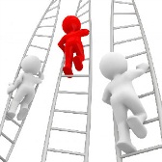

KEY COUNTRY DIFFERENCES
Countries to be evaluated:
Belgium
Czech Republic
Slovakia
Denmark
France
Germany
Netherlands
Portugal
Spain
United Kingdom
Switzerland
Debt crisis
Competitive environment
Government regulation
Wholesaler fragmentation
Notes:
Need to explain why we only evaluated the countries they’re in right now

Slide 19
KEY COUNTRY DIFFERENCES
Debt crisis
Countries to be evaluated:
Belgium
Czech Republic
Slovakia
Denmark
France
Germany
Netherlands
Portugal
Spain
United Kingdom
Switzerland
Manufacturers
Save by skipping middleman
Wholesalers
Pharmacies / Hospitals
Direct-to-Pharmacy is a way to maintain viability of debt-ridden countries
Notes:
Need to explain why we only evaluated the countries they’re in right now

Slide 20
KEY COUNTRY DIFFERENCES
Debt crisis
Countries to be evaluated:
Belgium
Czech Republic
Slovakia
Denmark
France
Germany
Netherlands
Portugal
Spain
United Kingdom
Switzerland
Manufacturers
25% UK is DTP & RWA
Direct to Pharmacy
6
of top 10 pharmaceuticals worldwide use DTP
Clear value proposition
Pharmacies
Direct-to-Pharmacy is feasible and desirable
Source: MarketResearch.com
Notes:
Need to explain why we only evaluated the countries they’re in right now

Slide 21
KEY COUNTRY DIFFERENCES
Wholesaler fragmentation
Countries to be evaluated:
Belgium
Czech Republic
Slovakia
Denmark
France
Germany
Netherlands
Portugal
Spain
United Kingdom
Switzerland
Minimum retaliation when buyer power is low.
11
13
15
UK
France
Germany
60
Spain
Spain has least risk of wholesaler retaliation
Notes:
Need to explain why we only evaluated the countries they’re in right now
Introduce DTP
25% of UK is DTP and RWA marketresearch.com
Top 20 pharmaceuticals and whether or not they have DTP (6/7 of the top 10 already have DTP) worldwide

Slide 22
KEY COUNTRY DIFFERENCES
Government regulation
Countries to be evaluated:
Belgium
Czech Republic
Slovakia
Denmark
France
Germany
Netherlands
Portugal
Spain
United Kingdom
Switzerland
Nordic countries:
5
Languages
4
Currencies
5
Legislation
5
Medical agencies
Denmark:
lowest 0.05 pharmacies per 100,000 inhabitants
Not worth considering due to inability to replicate results and small market size
Notes:
Single channel market

Slide 23



KEY COUNTRY DIFFERENCES
Competitive environment
Countries to be evaluated:
Belgium
Czech Republic
Slovakia
Denmark
France
Germany
Netherlands
Portugal
Spain
United Kingdom
Switzerland
Strong
Weak
UK
France
Italy
Spain
Germany
Germany
Italy
UK
France
Spain
Germany
France
UK
Italy
Spain
Movianto has presence in Spain, but is a location where no competitors are strong
Notes:
p.8

Slide 24
DIRECT TO PHARMACY
Spain
UK
Germany
France
Direct to Pharmacy
Scout out leading manufacturers
Gain stronghold
5 chain pharmacies
1 buying group
Realize more efficiencies
Further develop where Movianto is strong
Goal: Becoming top of mind logistics provider in health care industry
Notes:
Alliance Boots 2500
Coop Pharmacy 800
Lloyds Pharmacy 1600
Newmark 2000 independent pharmacies (buying group)
Rowlands 500
Superdrug 225

Slide 25
DIRECT TO PHARMACY
Spain
UK
Germany
France
Direct to Pharmacy
Scout out leading manufacturers
Gain stronghold
5 chain pharmacies
1 buying group
Realize more efficiencies
Further develop where Movianto is strong
Services
Labeling & Packaging
Delivery
Payment management
Inventory management
Information management
Goal: Becoming top of mind logistics provider in health care industry
Notes:
Alliance Boots 2500
Coop Pharmacy 800
Lloyds Pharmacy 1600
Newmark 2000 independent pharmacies (buying group)
Rowlands 500
Superdrug 225

Slide 26
VALUE PROPOSITION
To Manufacturer
To Pharmacy
Direct communication with pharmacy
Less inventory space
Increased margins without middleman
More flexible delivery times
Focus on core competencies
Avoids cost to middleman
Safety due to full ownership until POS
80% of Poland pharmacies ordered within 2 months of DTP being established
Win-win solution for manufacturer and pharmacies exist
Notes:
Alliance Boots 2500
Coop Pharmacy 800
Lloyds Pharmacy 1600
Newmark 2000 independent pharmacies (buying group)
Rowlands 500
Superdrug 225

Slide 27


IMPLEMENTATION IN SPAIN
Employ sales force from current DTP markets
Develop capacity in relabeling and repackaging plants
Individuals who are fluent in Spanish
Develop management systems for use in Spain
Develop unique value proposition for prospective clients
Ensure logistics chains are at capacity needed
Investment needed in Spain prior to sourcing clients

Slide 28

POTENTIAL CLIENTS
Seek out potential clients
Sales force to ease transition
Top manufacturers | Current delivery method
Pfizer | Alliance
Johnson & Johnson
Novartis | Direct
GlaxoSmithKline | Direct
Sanofi-Aventis | AAH, Alliance
AstraZeneca
Abbott Laboratories
Merck & Co.
Many global clients can be sought out for DTP
Source: www.dispensingdoctor.org

Slide 29
REPLICATE SUCCESS
United Kingdom expansion in 2016
Similar approach with experienced sales force
Closer relationships with pharmacies
Realize more efficiencies through info mgmt
Increase capacity if necessary
UK needs more pharmacy-level support

Slide 30
BRINGING O&M’S EXPERIENCE TO EU
How can Owens & Minor integrate Movianto acquisition and deliver quality health on global scale?
Where you
are now
Movianto’s needs to be effectively integrated into O&M’s organizational culture
Each country in Europe has unique industry structure
Benefits from O&M’s pre-existing US knowledge in EU are uncertain
Challenges
Adapt Movianto to O&M’s culture
Optimize distribution structure
Integrate O&M’s experience to new markets
Strategy
Owens & Minor will dominate the relationship between manufacturers and point of care providers
Where you will be

Slide 31
OPPORTUNITIES FOR EXPANSION
US MARKET
EU MARKET
Medical
Devices
3PL
Medical
Devices
3PL
Distribution/Wholesaling
Distribution/Wholesaling
Drugs
3PL
Drugs
3PL
Distribution/Wholesaling
Distribution/Wholesaling

Slide 32
OPPORTUNITIES FOR EXPANSION
US MARKET
EU MARKET
Medical
Devices
3PL
Medical
Devices
3PL
Distribution/Wholesaling
Distribution/Wholesaling
Drugs
3PL
Drugs
3PL
Distribution/Wholesaling
Distribution/Wholesaling
In long term, many opportunities exist to capitalize on the expertise of O&M and Movianto in EU and US markets and build towards companies vision.

Slide 33
US MARKET - DRUGS
MANUFACTURERS DEMAND:
ENTERING US DRUG MARKET:
Expertise
Does not satisfy
OM Divested drug distribution in 1992
Reach
Does not satisfy
No supply chain in place to aid expansion
Reliability
Does not satisfy
With no supply chain or expertise it’s hard for clients to trust O&M
Flexibility
Satisfies
With history of divesting from pharmaceutical logistics, O&M should not bring Moviento’s operations to the US market

Slide 34
EU MARKET – DRUG DISTRIBUTION
MANUFACTURERS DEMAND:
ENTERING EU DRUG DISTRIBUTION:
Expertise
Does Not Satisfy
O&M is unfamiliar with EU market and drug distribution is not a core competency
Reach
Does Not Satisfy
High capital investments are required to build the infrastructure
Reliability
Uncertain
O&M strengths aren’t proven to clients
Flexibility
Satisfies
Need for high capital investments and high level of competition in this market do not present a lucrative opportunity for expansion

Slide 35
EU MARKET – SUPPLIES
MANUFACTURERS DEMAND:
ENTERING EU SUPPLIES:
Expertise
Satisfies
Reach
Satisfies
Reliability
Uncertain
O&M strengths aren’t proven to clients
Flexibility
Satisfies
Expansion into EU medical supplies market will leverage O&M’s core competencies as well as capitalize on Movianto’s existing relationships

Slide 36
ENTERING EU SUPPLY MARKET
SETTING UP SUPPLIES OPERATIONS IN EU
Point-of-care connections in EU
Supplies manufacturer in EU
Supplies manufacturer in US
Movianto’s EU Connections
Develop New Relationships
O&M’s US Connections
Leverage Movianto’s existing relationships with point-of-care providers for a strong value proposition for US and EU suppliers to do business with O&M supply distribution in EU.

Slide 37
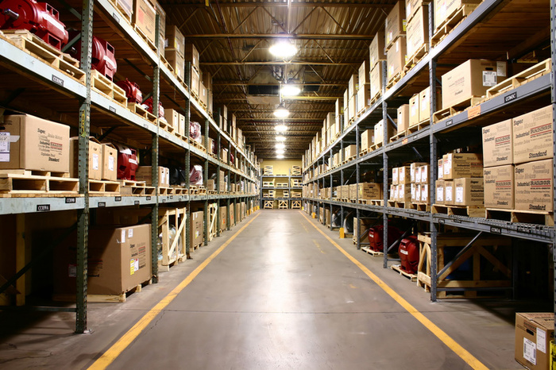
ENTERING EU SUPPLY MARKET
MOVIANTO’S OPERATIONS
In 2018
29 warehouses
Upgrade ½ of warehouses to service supplies industry
Focus on biggest markets – UK, Germany and France
Expand into EU medical supplies market in 2018 by converting existing warehouses used for 3PL services

Slide 38
1
Challenges
2
Recommendations
3
Timeline
4
Financial Feasibility
5
Risks & Mitigations

Slide 39
IMPLEMENTATION TIMELINE
 | 2013 | 2014 | 2015 | 2016 | 2017 | 2018 | 2019
Integrating Movianto
Develop educational resources
OM-Movianto Summit
Training management and key team members
Management communicates to team
Improving EU Operations
SPAIN: Hire sales force
SPAIN: Develop logistics capacity
SPAIN: Find prospective clients
UK: Hire Sales Force
UK: Develop logistics capacity
UK: Find prospective clients
Expand Into Med Supplies in EU
Upgrade warehouses in UK, Germany, France
Service existing relationships
Develop new relationships

Slide 40
1
Challenges
2
Recommendations
3
Timeline
4
Financial Feasibility
5
Risks & Mitigations

Slide 41
ASSUMPTIONS
Will expand European market share with positive trends and synergies

Slide 42
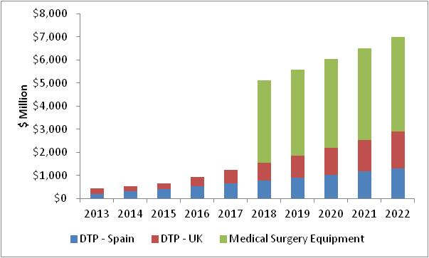
REVENUE BREAKDOWN
Movianto:
Spain CAGR: 20%
UK CAGR: 22%
Medical Instruments:
CAGR: 3%
By 2022, Medical Instruments will account for 60% of total sales

Slide 43
COST BREAKDOWN
DTP SPAIN & UK
Construct 2 facilities in 2013
~$28 million
in capex for 2013
$14 million per facility
MEDICAL INSTRUMENTS
Upgrade 15 facilities by 2018
$7 million per facility
~$105 million in capex for 2018

Slide 44
FINANCIAL PERFORMANCE 2013-2022
Revenue CAGR
32%
EBITDA CAGR
35%
EBITDA Margin
3-3.5%
Total EV of OMI increase by 33%
Equivalent to $712 million

Slide 45
1
Challenges
2
Recommendations
3
Timeline
4
Financial Feasibility
5
Risks & Mitigations

Slide 46
RISKS AND MITIGATIONS
RISK | PROBABILITY | SEVERITY | MITIGATION
Probability of receiving backlash from wholesales | 20% | Medium | Delaying advance to larger markets to build confidence in strategy
Movianto can’t secure Johnson & Johnson as a client | 35% | Low | Use another of top manufacturer that isn’t in DTP
DTP model proves unsuccessful in Spain | 15% | Medium | Adjust the model, marketing, location or partner
Pharmacies don’t want to order from many manufacturers | 40% | Low | Establish RFID tracking system to simplify process
Notes:
Also they will only be able to get the drugs from the manufacturers so that sucks for them
And they save money by doing so

Slide 47
Thank you!
QUESTIONS?

Slide 48
APPENDICES

Slide 49
CAPITAL EXPENDITURE

Slide 50
BASE CASE: FREE CASH FLOW

Slide 51
BASE CASE – MOVIANTO SPAIN

Slide 52
BASE CASE – MOVIANTO UK

Slide 53
BASE CASE – MEDICAL INSTRUMENTS

Slide 54
BASE CASE – AGGREGATE FIRM

Slide 55
BULL CASE – MOVIANTO SPAIN

Slide 56
BULL CASE – MOVIANTO UK

Slide 57
BULL CASE – MEDICAL INSTRUMENTS

Slide 58
BULL CASE – AGGREGATE FIRM

Slide 59
BEAR CASE – MOVIANTO SPAIN

Slide 60
BEAR CASE – MOVIANTO UK

Slide 61
BEAR CASE – MEDICAL INSTRUMENTS

Slide 62
BEAR CASE – AGGREGATE FIRM

Slide 63
SWOT ANALYSIS
 | Things to leverage | Things to mitigate
Internal | Strengths | Weaknesses
 | Huge presence in USA Complete understanding of supply chain logistics Global reach increased with purchase of Movianto | Heavy dependence on few clients in USA Dependent on Celsio’s business clients
External | Opportunities | Threats
 | Market shift to DTP and RWA Increased efficiencies in supply chain logistics Purchase of Movianto adds new markets to explore | Big 3 taking over entire wholesale/distributor market Changes in European Commission can influence future plans Euro debt crisis

Slide 64
PORTER’S 5 FORCES (EUROPE)
Supplier Power: MEDIUM
Buyer Power: MEDIUM
Many manufacturers of varying sizes and importance
Decreasing margins in cost cutting wholesale markets
All competitors in DTP market too
Rivalry: HIGH
Heavy competition by main 3 competitors
Barriers to Entry: Medium
Substitutes: LOW
Costs are high to enter
Established logistics solution companies can find a reason to go into lucrative healthcare logistics
Highly differentiated service – cold chain

Slide 65
PORTER’S 5 FORCES (USA)
Supplier Power: MEDIUM
Buyer Power: High
Many manufacturers of varying sizes and importance
Few major groups can switch to another distributor
Rivalry: Medium
Market leader with 1 major competitor
Barriers to Entry: High
Substitutes: LOW
Costs are high to enter
Very hard to steal a buyer
Potentially high although there are reasons why a health care distributor is needed

Slide 66

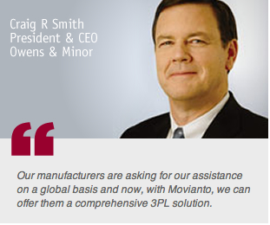
WHY HAS O&M ACQUIRED MOVIANTO?
Innovative solutions for positive patient outcomes
Taking healthcare logistics to the next level
Helping manufacturers make impact globally
Movianto was acquired to build towards Owen & Minor’s long-term vision of dominating the distribution services in healthcare products market.
Source: ommovianto.com
Notes:
According to companies website and case information:
TOGETHER WE ARE STRONGER:
innovative solutions for positive patient outcomes
taking healthcare logistics to the next level
helping manufacturers make impact globally

Slide 67
DTP PARTNERS
Pfizer | United States | Alliance
Johnson & Johnson | United States
Hoffmann–La Roche | Switzerland | Direct
Novartis | Switzerland | Direct
GlaxoSmithKline | United Kingdom | AAH, Alliance
Sanofi-Aventis | France
AstraZeneca | United Kingdom/ Sweden | AAH, Alliance
Abbott Laboratories | United States
Merck & Co. | United States
Bristol-Myers Squibb | United States | Direct
Eli Lilly and Company | United States | AAH, Phoenix
Boehringer Ingelheim | Germany
Takeda Pharmaceutical Co. | Japan | Clarity for DTP
Bayer | Germany | Direct
Amgen | United States
Genentech | United States
Baxter International | United States
Teva Pharmaceutical Industries | Israel
Astellas Pharma | Japan | Alliance
Daiichi Sankyo | Japan
Source: www.dispensingdoctor.org

Slide 68
DTP PARTNERS
Pfizer | United States | Alliance
Johnson & Johnson | United States
Hoffmann–La Roche | Switzerland | Direct
Novartis | Switzerland | Direct
GlaxoSmithKline | United Kingdom | AAH, Alliance
Sanofi-Aventis | France
AstraZeneca | United Kingdom/ Sweden | AAH, Alliance
Abbott Laboratories | United States
Merck & Co. | United States
Bristol-Myers Squibb | United States | Direct
Eli Lilly and Company | United States | AAH, Phoenix
Boehringer Ingelheim | Germany
Takeda Pharmaceutical Co. | Japan | Clarity for DTP
Bayer | Germany | Direct
Amgen | United States
Genentech | United States
Baxter International | United States
Teva Pharmaceutical Industries | Israel
Astellas Pharma | Japan | Alliance
Daiichi Sankyo | Japan
Source: www.dispensingdoctor.org

Slide 69
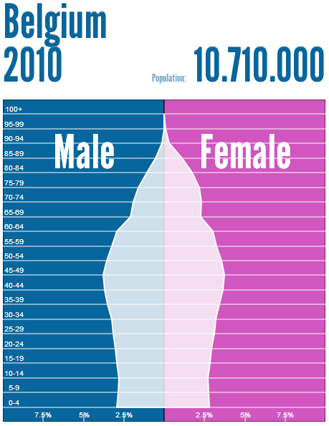
POPULATION PYRAMID
Source: Population Pyramid

Slide 70
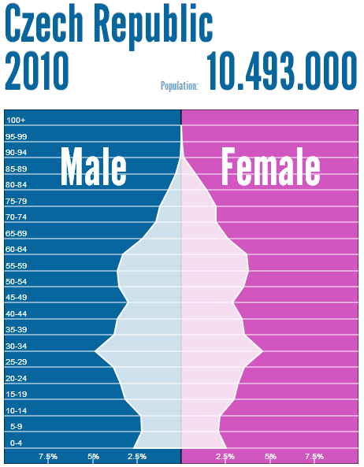
POPULATION PYRAMID
Source: Population Pyramid

Slide 71
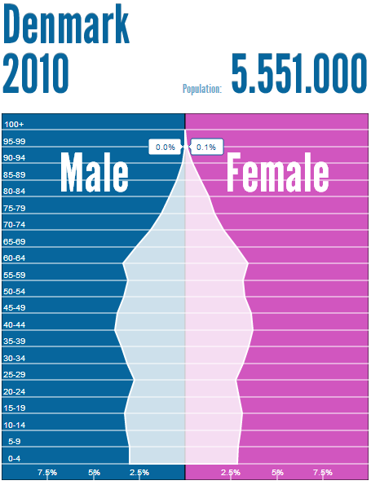
POPULATION PYRAMID
Source: Population Pyramid

Slide 72
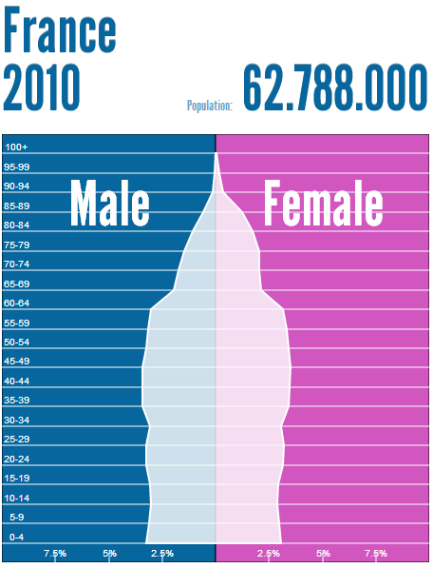
POPULATION PYRAMID
Source: Population Pyramid

Slide 73
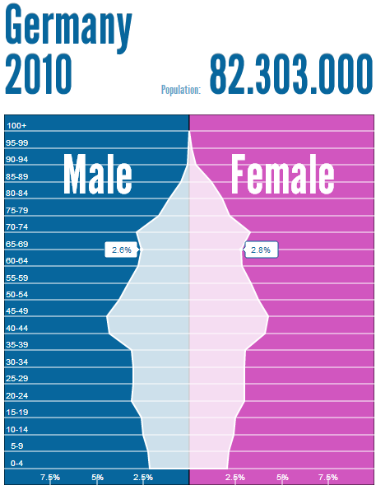
POPULATION PYRAMID
Source: Population Pyramid

Slide 74
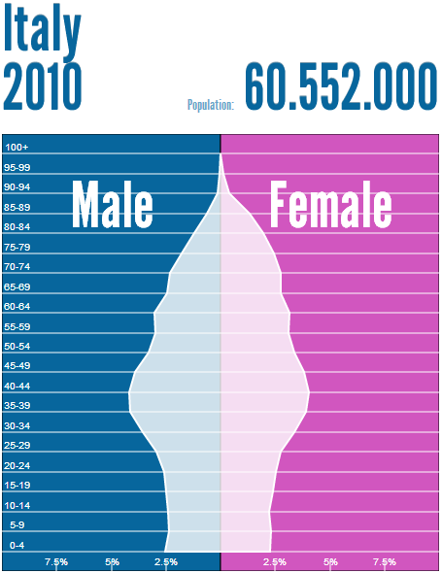
POPULATION PYRAMID
Source: Population Pyramid

Slide 75
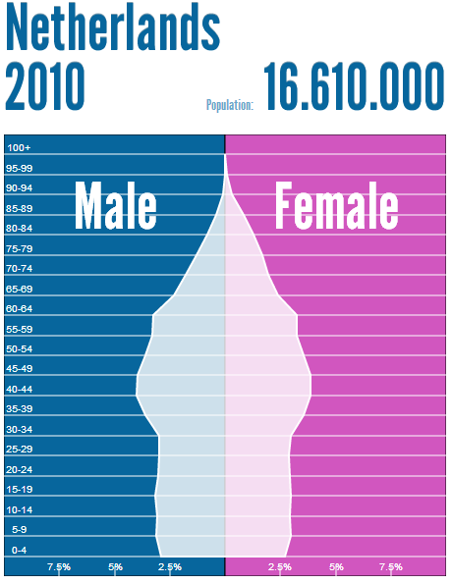
POPULATION PYRAMID
Source: Population Pyramid

Slide 76
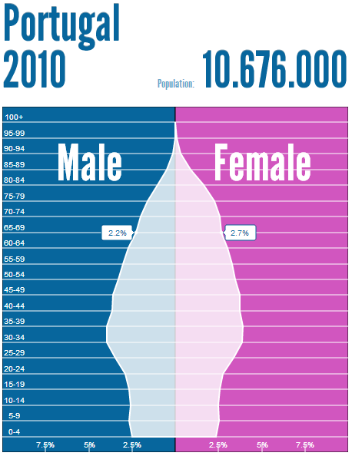
POPULATION PYRAMID
Source: Population Pyramid

Slide 77
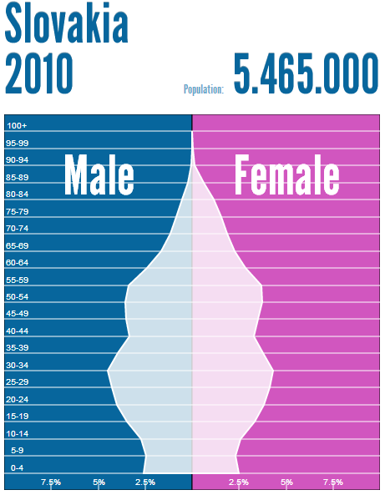
POPULATION PYRAMID
Source: Population Pyramid

Slide 78
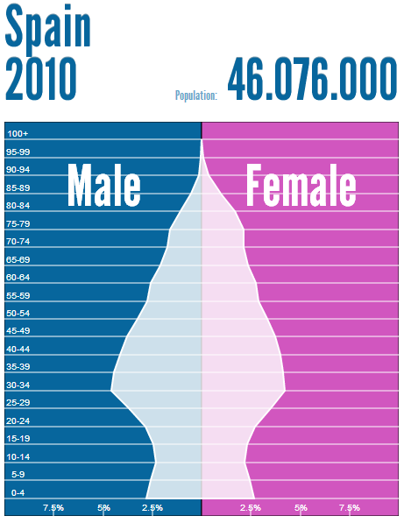
POPULATION PYRAMID
Source: Population Pyramid

Slide 79
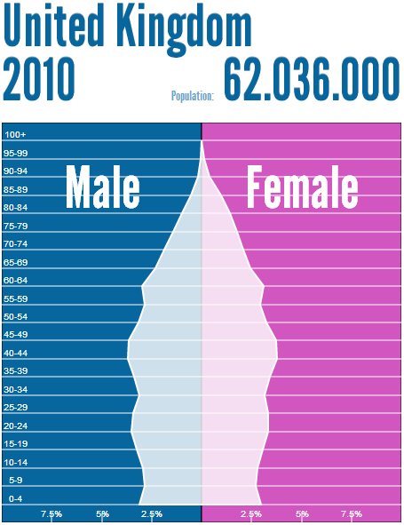
POPULATION PYRAMID
Source: Population Pyramid

Slide 80

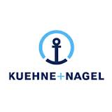








FUTURE COMPETITORS

Slide 81
POTENTIAL RFID SYSTEM
Goods are labeled with tracker and noted when sold
Goods are automatically ordered based on quantity
Results are compiled and efficiencies are sought out
Costs include:
RFID Tags $0.07-0.15
RFID Scanner $200 (cost covered by pharmacy)
RFID Management Software $100,000

Slide 82
LONG-TERM POTENTIAL ISSUES
If DTP implemented in both potential trade areas then the additional parallel trade incentives are the same as before DTP
Parallel trade from Spain and other low cost (high reimbursement) centers
European Commission allows for more vertical integration in 3-5 years and more ownership opportunities available
Look at potential opportunities and if they fit into any of the plans that O&M or Movianto is looking into

