Slide 1
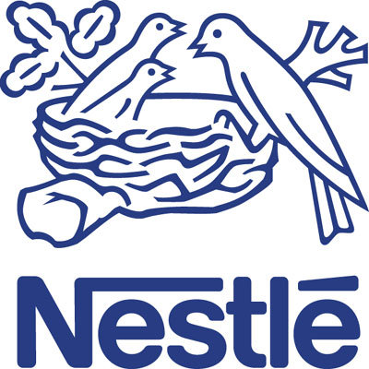
d Nestlé Good Food, Good Life Nutrition, Health and Wellness
BY: VICTOR-Y

Slide 2
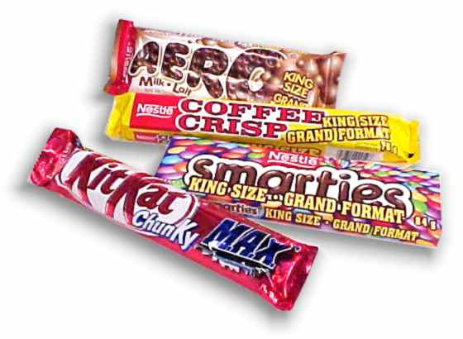
Agenda
Nestlé USA Overview
Situation Analysis
Issues & Objectives
Recommendations
Financial Justification
Key Success Factors
Conclusion

Slide 3
Nestlé USA
Subsidiary of Nestlé S.A. – the world's largest food company
$8.25 billion in sales in 2007 - accounted for 24% of total global volume
Offer wide range of products
Chocolate and confections, beverages, infant formula, juices, mile products, pet food, prepared food, sports nutrition
Nestlé Overview
Situation Analysis
Issues & Objectives
Recommendations
Financial Justification
Key Success Factors
Conclusion

Slide 4
Nestlé USA
To develop a vision, strategy and tactics to grow the Nestlé nutrition, health and wellness presence in the confections space using existing Nestle USA brands
Nestlé Overview
Situation Analysis
Issues & Objectives
Recommendations
Financial Justification
Key Success Factors
Conclusion

Slide 5
Situation Analysis
Change in Consumer Needs
Increase in people’s health consciousness
Confectionary is perceived to be unhealthy
Declining Sales Growth Rate of Unhealthy Confection Products
Between 2006-07
Source: Nielsen
Unmet Consumer Needs in Confectionary Products
Nestlé Overview
Situation Analysis
Issues & Objectives
Recommendations
Financial Justification
Key Success Factors
Conclusion

Slide 6
Situation Analysis
Competitive Industry
5-year average industry revenue increased by 0.8% only
The industry is in the mature stage of the life cycle
Acquisition of Wringley by Mars, leading to concentrated market
Source: MICC2009 case materials
Low Market Share
Nestlé Overview
Situation Analysis
Issues & Objectives
Recommendations
Financial Justification
Key Success Factors
Conclusion

Slide 7
Situation Analysis
Impulse Segment
70% unplanned impulse purchasing
Retail presence and the prevalence of convenience stores drive demand
Sales are seasonal
Lack of Impulse Demand Drivers
Nestlé Overview
Situation Analysis
Issues & Objectives
Recommendations
Financial Justification
Key Success Factors
Conclusion

Slide 8
Issues & Objectives
Where are we today
Nestle in five years
Nestle USA confection division
is under the turn around period
where health and nutrition have
become important determinants.
Has sales of US$ 3,250 million.
To expand Nestlé’s Nutrition, Health and
Wellness presence within its USA
confection division and achieve sales of
US$ 3,650 million.
Issues at hand
How to meet changes in consumer demand?
To break away from unhealthy image and re-establish Nestle confectionary as a healthy source of goodness that will enable Nestle to best satisfy consumer needs
How to capture more market share?
To aggressively develop product innovation platforms
How to increase demand driver?
To raise brand presence and awareness through more efficient and productive consumer communication and merchandising strategy
Nestlé Overview
Situation Analysis
Issues & Objectives
Recommendations
Financial Justification
Key Success Factors
Conclusion

Slide 9
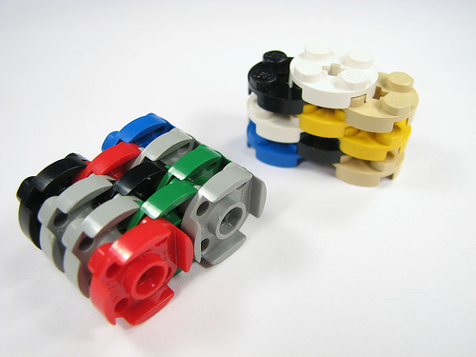
Strategy Overview
1. Minus
2. Plus
+
3. Multiply
Nestlé Overview
Situation Analysis
Issues & Objectives
Recommendations
Financial Justification
Key Success Factors
Conclusion

Slide 10
Guilt Free!
New versions:
- Sugar free, dark chocolate
More & Less
Website contains nutritional facts
Promote bite size = well balanced
Wanna have a bite?
No Guilt!
Nestlé Overview
Situation Analysis
Issues & Objectives
Recommendations
Financial Justification
Key Success Factors
Conclusion

Slide 11
Strategy Overview
1. Minus
2. Plus
+
3. Multiply
Nestlé Overview
Situation Analysis
Issues & Objectives
Recommendations
Financial Justification
Key Success Factors
Conclusion

Slide 12
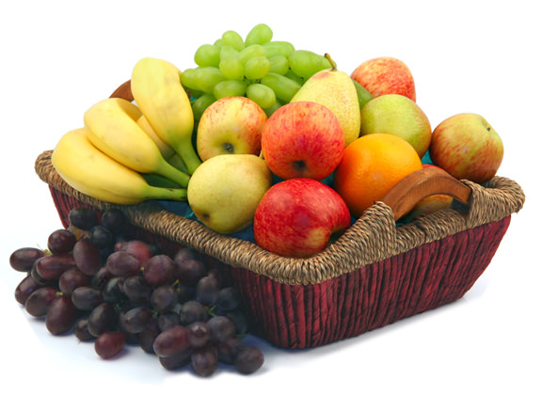
Fruitti Coco
1
Dried Fruits covered in chocolate
Apple, Berry, Apricots
Pineapple, Fruits
Milk Chocolate,
Dark Chocolate
Source: Nielsen & Strat Planner
Nestlé Overview
Situation Analysis
Issues & Objectives
Recommendations
Financial Justification
Key Success Factors
Conclusion

Slide 13
Fruitti Coco
Real Fruit
Real Chocolate
Indulgence
Healthfulness
MICRONUTRIENTS:
Source of Vitamin C, A and E
Collagen
Rich in antioxidants
Low fat
Phenyl ethylamine, a mild mood elevator.
Oleic acid help raise good cholesterol
Flavanoids in chocolate may help keep
blood vessels elastic
Target Segment
Male & female 18-64
Those who enjoy the combination of sweetness of chocolate and the nutritious of fruits
Packaging
100 calories bags
Larger size with zip lock to allow for storage and maintain freshness
Poppable for berries
Nestlé Overview
Situation Analysis
Issues & Objectives
Recommendations
Financial Justification
Key Success Factors
Conclusion

Slide 14
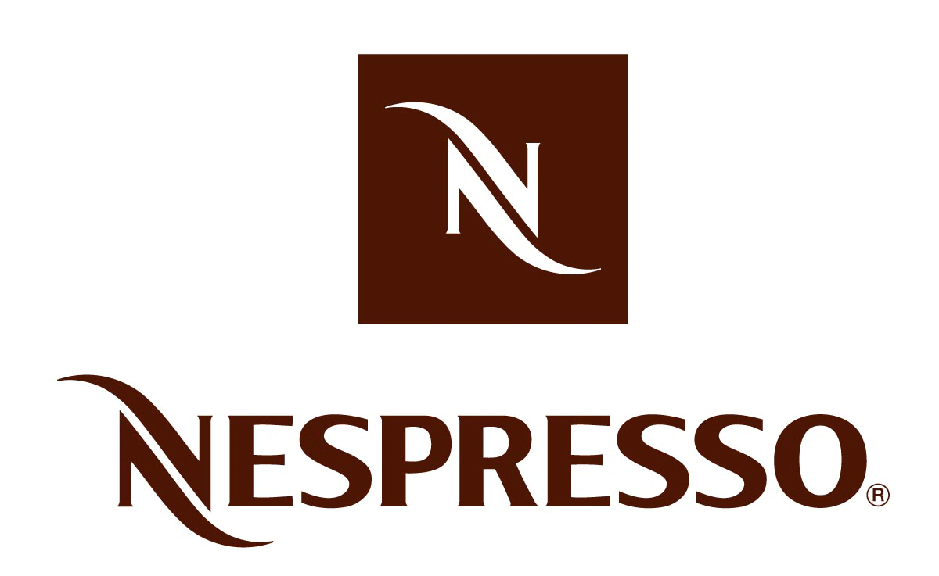
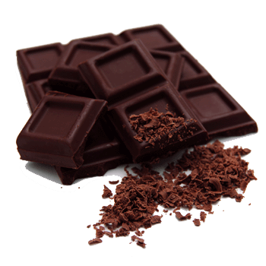
Taste the Lifestyle
2
Boots up Relaxation
Antioxidants
Keep Blood Vessel Elastics
Chocolate contains phenyl ethylamine
Prevention & treatment of several diseases and illnesses
Endure performance in long-duration physical activities
Nestlé Overview
Situation Analysis
Issues & Objectives
Recommendations
Financial Justification
Key Success Factors
Conclusion
Notes:
Nespresso is the fastest growing among the most important brands at a company. coffee has been labeled with the stigma of being unhealthy.
In fact, nothing could be further from the truth. moderate coffee consumption doesn't cause harm, it's also uncovered possible benefits. Alzheimer's disease, diabetes, liver disease, skin cancer, Parkinson's disease and more. Coffee may reduce the risk of developing gallstones, discourage the development of colon cancer, improve cognitive function, reduce the risk of liver damage in people at high risk for liver disease, and reduce the risk of Parkinson's disease. Coffee has also been shown to improve endurance performance in long-duration physical activities. It not only protects you against a variety of serious diseases, but can also bring a lot of pleasure into your life. * The smell of chocolate may increase theta brain waves, resulting in relaxation. * Chocolate contains phenyl ethylamine, a mild mood elevator. * The cocoa butter in chocolate contains oleic acid, a mono-unsaturated fat which may raise good cholesterol.

Slide 15
Taste the Lifestyle
Nespresso: 30 % growth in 2008
18 billion USD market
150 million Americans coffee daily drinker
Source: National Coffee Association of U.S.A, Inc
Nestlé Overview
Situation Analysis
Issues & Objectives
Recommendations
Financial Justification
Key Success Factors
Conclusion
Notes:
Presenting its 2008 earnings Thursday, Nestlé said sales of Nespresso products had grown 30 percent in 2008, taking annual revenue past its target of 2 billion Swiss francs, or $1.7 billion, two years ahead of schedule.
Though it represents about 5 percent of overall Nestlé sales of 110 billion francs, Nespresso is the fastest growing among the most important brands at a company

Slide 16
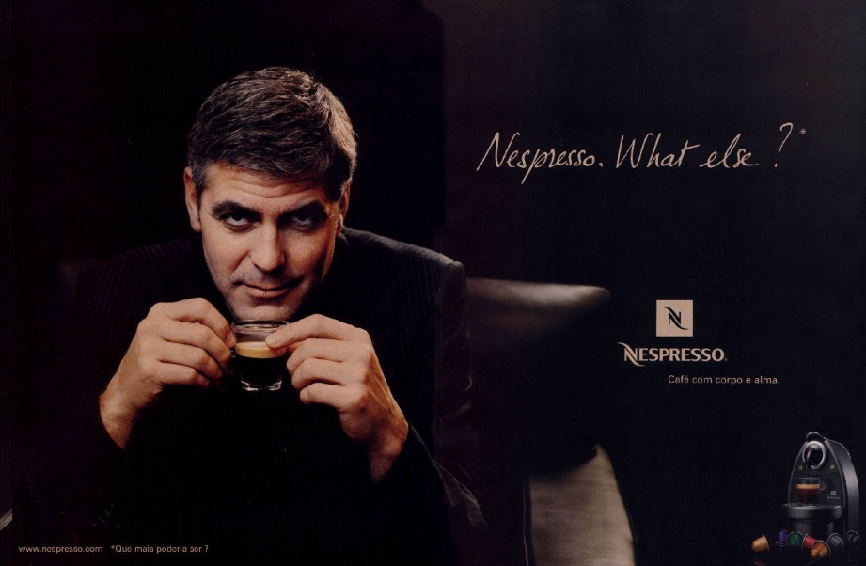
Taste the Lifestyle
Complimentary Product to Nespresso
Channels of Distribution
Online
High-end Hotel, restaurant, travel
Customer Care & Luxury Retail
Target Customer
18+
Coffee Lover
Hi-end
Nestlé Overview
Situation Analysis
Issues & Objectives
Recommendations
Financial Justification
Key Success Factors
Conclusion
Notes:
coffee has been labeled with the stigma of being unhealthy.
In fact, nothing could be further from the truth. moderate coffee consumption doesn't cause harm, it's also uncovered possible benefits. Alzheimer's disease, diabetes, liver disease, skin cancer, Parkinson's disease and more. Coffee may reduce the risk of developing gallstones, discourage the development of colon cancer, improve cognitive function, reduce the risk of liver damage in people at high risk for liver disease, and reduce the risk of Parkinson's disease. Coffee has also been shown to improve endurance performance in long-duration physical activities. It not only protects you against a variety of serious diseases, but can also bring a lot of pleasure into your life. * The smell of chocolate may increase theta brain waves, resulting in relaxation. * Chocolate contains phenyl ethylamine, a mild mood elevator. * The cocoa butter in chocolate contains oleic acid, a mono-unsaturated fat which may raise good cholesterol.

Slide 17
Strategy Overview
1. Minus
2. Plus
+
3. Multiply
Nestlé Overview
Situation Analysis
Issues & Objectives
Recommendations
Financial Justification
Key Success Factors
Conclusion

Slide 18
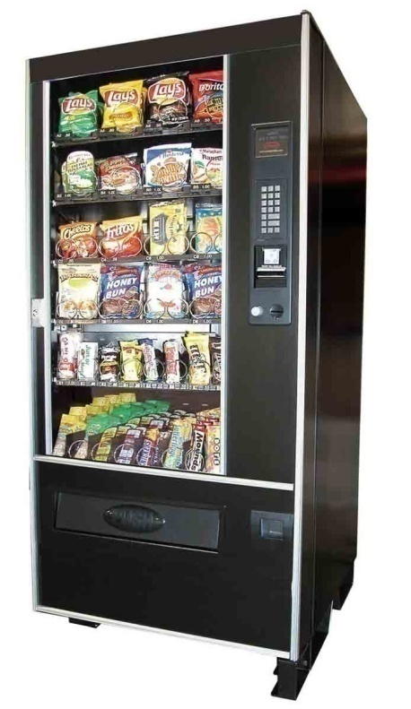
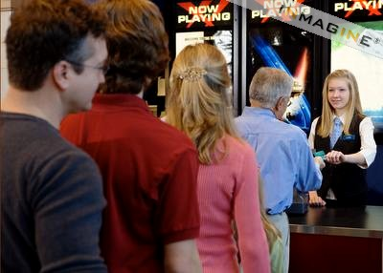
Merchandising Strategy
Guilt Free Vending Machines
Available at:
Self paid restaurants
Bookstores
Shopping malls
Increased dine out
30%-50% of consumer spending
Create an impulsive need
70% unplanned buying
Nestlé Overview
Situation Analysis
Issues & Objectives
Recommendations
Financial Justification
Key Success Factors
Conclusion

Slide 19
Implementation Plan
2009
2010
2011
2012
2013
Minus
Guilt Free!
Plus
Fruitti Coco
NespressoChocolate
Multiply
EasyAccessSpots
Vending Machines
Nestlé Overview
Situation Analysis
Issues & Objectives
Recommendations
Financial Justification
Key Success Factors
Conclusion

Slide 20
Forecasted Confectionery Sales
Year | 2008 | 2009(F) | 2010(F) | 2011(F) | 2012(F) | 2013(F)
Sales (In Millions of USD) | 3,250 | 3,300 | 3,400 | 3,480 | 3,550 | 3,650
CAGR= 3.28%
Nestlé Overview
Situation Analysis
Issues & Objectives
Recommendations
Financial Justification
Key Success Factors
Conclusion

Slide 21
Forecasted Confectionery Net Income
Year | 2008 | 2009(F) | 2010(F) | 2011(F) | 2012(F) | 2013(F)
NI (In Millions of USD) | 435 | 390 | 495 | 540 | 570 | 620
CAGR= 2.90%
Nestlé Overview
Situation Analysis
Issues & Objectives
Recommendations
Financial Justification
Key Success Factors
Conclusion

Slide 22
Cost Estimation
In Millions of USD
Incremental Expenses (Total 5-year expenses)
Renting Space | 80
Distribution | 60
R&D | 135
Advertising | 15
Total Expenses | 290
USD 352.26 million
NPV
Source of Funds
Equity
CAPEX
Vending Machine | 2.5
Machinery & Equipment | 50
Total CAPEX | 52.5
Nestlé Overview
Situation Analysis
Issues & Objectives
Recommendations
Financial Justification
Key Success Factors
Conclusion

Slide 23
Key Success Factors
Ability to leverage research into products & services
Clear vision for the future
Brand Portfolio
Nestlé Overview
Situation Analysis
Issues & Objectives
Recommendations
Financial Justification
Key Success Factors
Conclusion

Slide 24
Conclusion
Unmet Consumer Needs in Confectionary Products
Guilt Free Campaign
Low Market Share
Fruitti Coco
Nespresso Chocolate
Lack of Impulse Demand Drivers
Vending Machines
Easy access spots
Nestlé Overview
Situation Analysis
Issues & Objectives
Recommendations
Financial Justification
Key Success Factors
Conclusion

Slide 25
Q & A

Slide 26
Slide Navigator
Main Presentation:
Introduction
Nestlé’s Vision
Situational Analysis
Unmet Consumer Needs
Low Market Share
Lack of Impulse Demand Drivers
Issues & Objectives
Strategy Overview
Guilt Free Strategy
Fruitti Coco
Taste the Lifestyle
Merchandising Strategy
Implementation Plan
Forecasted Sales
Forecasted Net Income
Cost Estimation
Key Success Factors
Conclusion
BACK UP
Confectionary = obesity?
Why Nespresso?
High end ?
Why not nuts?
Sugar free safe?
Candy ?
Fruit successful?
Nestle at Restaurant?
Forecasted Sales
Forecasted NI
Cost Estimation
Share Dilution

Slide 27
Why are people blaming confectionery for the increase in obesity?
When people consume more calories than they expend in terms of activity they will gain weight. This could occur with a whole range of foods. It is unfair to single out confectionery to blame. The most recent nutrition survey clearly shows confectionery represents only a small proportion of the daily kilojoule intake (2% in adults; 4% in children), hence it clearly cannot be a major contributor to overweight.

Slide 28
Why choosing Nespresso?
Not an impulsive buy
Product line extension
High end market
Enjoy the flavor at any time of the day
Meet existing customer need
All 12 flavors
Pull strategy

Slide 29
High end market - Nespresso
Benefit from a profiting product
Increase satisfaction of current customer
Fruit chocolates
Mass market appeal
Healthy snack for all ages

Slide 30
Why not nuts?
Intense competition
High fat
Recongnized brands exist
Not innovative

Slide 31
Sugar-free products are made with chemicals is it safe?
Sugarfree products are made with ingredients that have been vigorously tested and approved by Food Standards.
Non-sugar sweeteners are absolutely safe to consume. Foods with added aspartame and aspartame-acesulphame salt come with a warning alert to the one in 10,000 people with phenylketonuria (PKU) who have difficulty metabolising aspartame.
Non-sugar sweeteners offer consumers particular benefits compared to their regular counterpart, for example, kilojoule reduction.

Slide 32
CANDY
REDUCED SUGAR
Use real juice –vitamin C
Nerds, goober etc

Slide 33
FRUITS in chocolate
40% interested in real milk products
29% interested in antioxidants
27% interested in REAL FRUIT
FRUITS is the most common snack
Nestle custom consumer survey, 2007

Slide 34
Nestle + Restaurants
Do not offer deserts
Pay rent
Pay royalties
Only snack available
Long shelf life

Slide 35
Forecasted Sales
Existing = 0.08% of last year sales
Guilt Free = 40% of health and wellness confections (dark chocolate = 44% from case pg11)
Fruitti Coco = 20% of health and wellness confections ( chocolate raisin=16%)
New channels = 0.04% of existing sales
Nestle Confection’s growth rate = 0.99%
Industry growth rate= 0.8%
Hershey’s CAGR = 3.7%

Slide 36
Forecasted Net Income
Existing profit = 13.1%
With implemented strategies, the profits increase as shown in the line graph
Net income’s CAGR = 2.9% compared with 0.08% over the past 5-year period

Slide 37
Cost Estimation
Renting space = 8 USD per day
Distribution = 8% of increased sales
R&D = 1.8% of increased sales
Advertising = 15% of increased sales (from 33%)
Vending machines = 1200*2000
PPE =50
* Discount rate = 5% (interest rate)
* Sales approach from F/S 2008

Slide 38
Dilute shares
Stock price 20/02/09 = 33.5USD
70 Million
No. of shares = 2M out of 383 M => insignificant amount

